Slide 1

University Institute of Engineering
DEPARTMENT OF COMPUTER SCIENCE & ENGINEERING
Bachelor of Engineering (Computer Science & Engineering)
Subject Name : Machine Learning
Subject Code: CST-316
Topic: Logistic Regression
Lecture-2.1
DISCOVER . LEARN . EMPOWER

Slide 2
Course Outcome
CO-1:Apply the basic concept of Machine learning and statistics learning to deal with real-life Problems.
CO-2: Understand different machine learning algorithms, as well as underlying theories the behind them.
CO-3: Select and apply the appropriate machine learning algorithm to solve problems of moderate complexity
CO-4: Interpret and evaluate models generated from data.
CO-5: Optimize the models learned and report on the expected accuracy that can be attained by applying the algorithms to a real-world problem.

Slide 3
Course Objective
To understand the history and development of Machine Learning.
To provide a comprehensive foundation to Machine Learning and Optimization methodology with applications t.
To study learning processes: supervised and unsupervised, deterministic and statistical knowledge of Machine learners, and ensemble learning
To understand modern techniques and practical trends of Machine learning.

Slide 4
Logistic Regression
Supervised classification algorithm.
In a classification problem, the target variable(or output), y, can take only discrete values for given set of features(or inputs), X.
We can also say that the target variable is categorical.
Logistic Regression
Dependent variable is binary: 1(True, Success) and 0(False, Failure)
Goal is to find best fitting model for independent and dependent variable relationship.
Independent variables can be continuous or binary.

Slide 5
Logistic Regression
Logistic Regression was used in the biological sciences in early twentieth century. It was then used in many social science applications.
Logistic Regression is used when the dependent variable(target) is categorical.
For example,
To predict whether an email is spam (1) or (0)
Whether the tumor is malignant (1) or not (0)

Slide 6
Types of Logistic Regression
Binomial:
Target variable can have only 2 possible types: “0” or “1” which may represent “win” vs “loss”, “pass” vs “fail”, “dead” vs “alive”, etc.
Multinomial:
Target variable can have 3 or more possible types which are not ordered(i.E. Types have no quantitative significance) like “disease A” vs “disease B” vs “disease C”.
Ordinal:
It deals with target variables with ordered categories. For example, a test score can be categorized as:“very poor”, “poor”, “good”, “very good”. Here, each category can be given a score like 0, 1, 2, 3.

Slide 7
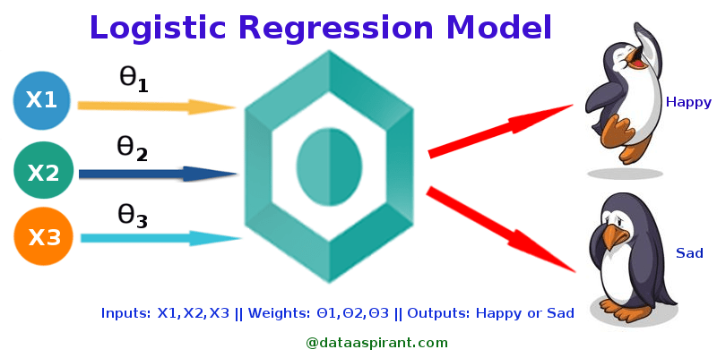
Graphical Representation: Logistic Regression

Slide 8
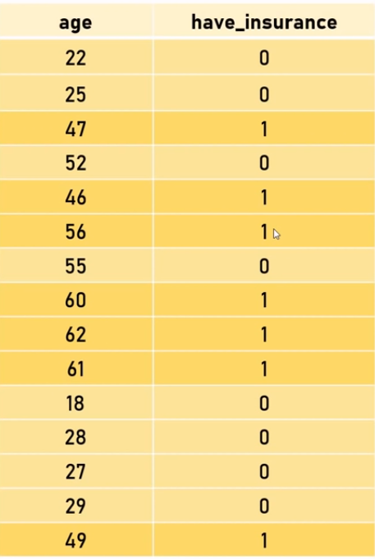
Insurance Data

Slide 9
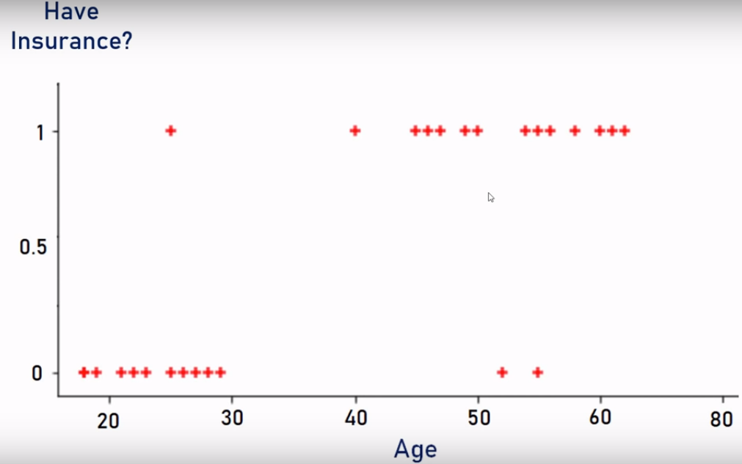

Slide 10
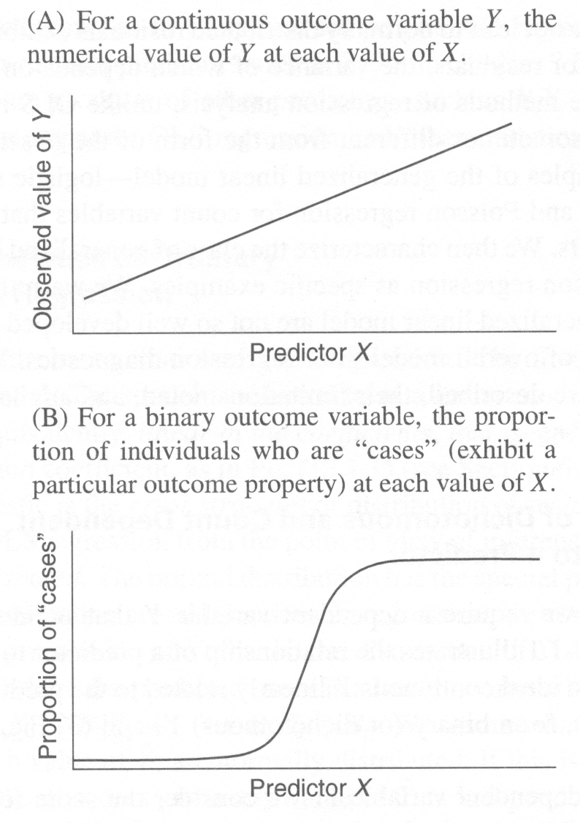
Logistic Regression vs Linear Regression

Slide 11
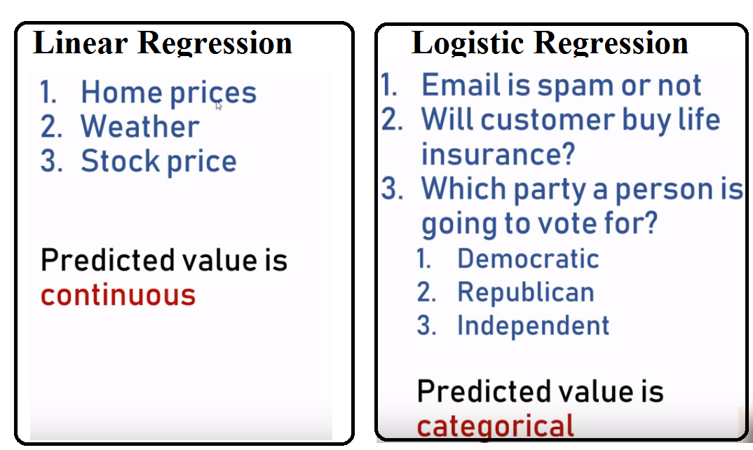

Slide 12
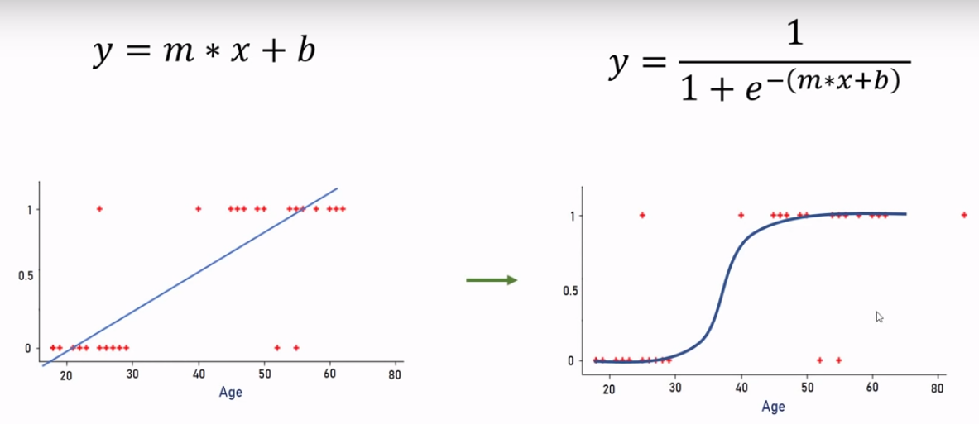
Sigmoid function convers input range 0 to 1
e= Euler’s number~2.71828

Slide 13
Logistic Regression
Consider a scenario where we need to classify whether an email is spam or not.
If we use linear regression for this problem, there is a need for setting up a threshold based on which classification can be done.
Say if the actual class is malignant, predicted continuous value 0.4 and the threshold value is 0.5, the data point will be classified as not malignant which can lead to serious consequence in real time.
From this example, it can be inferred that linear regression is not suitable for classification problem. Linear regression is unbounded, and this brings logistic regression into picture. Their value strictly ranges from 0 to 1.

Slide 14
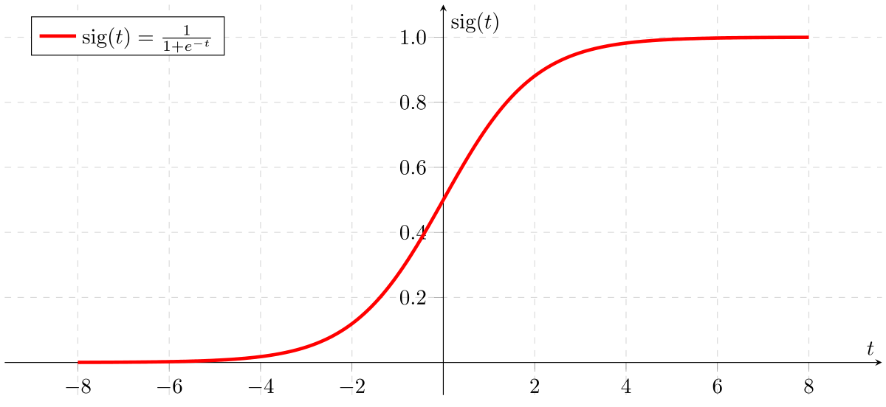
Model
Output = 0 or 1
Hypothesis => Z = WX + B
hΘ(x) = sigmoid (Z)
If ‘Z’ goes to infinity, Y(predicted) will become 1 and if ‘Z’ goes to negative infinity, Y(predicted) will become 0.

Slide 15
Logistic Regression-types
1. Binary Logistic Regression
The categorical response has only two 2 possible outcomes. Example: Spam or Not
2. Multinomial Logistic Regression
Three or more categories without ordering. Example: Predicting which food is preferred more (Veg, Non-Veg, Vegan)
3. Ordinal Logistic Regression
Three or more categories with ordering. Example: Movie rating from 1 to 5

Slide 16
Decision Boundary
To predict which class a data belongs, a threshold can be set.
Based upon this threshold, the obtained estimated probability is classified into classes.
Say, if predicted_value ≥ 0.5, then classify email as spam else as not spam.
Decision boundary can be linear or non-linear.
Polynomial order can be increased to get complex decision boundary.

Slide 17
References
Books and Journals
Understanding Machine Learning: From Theory to Algorithms by Shai Shalev-Shwartz and Shai Ben-David-Cambridge University Press 2014
Introduction to machine Learning – the Wikipedia Guide by Osman Omer.
Video Link-
https://www.youtube.com/watch?v=9f-GarcDY58
https://www.youtube.com/watch?v=GwIo3gDZCVQ
Web Link-
https://towardsdatascience.com/logistic-regression-detailed-overview-46c4da4303bc

Slide 18
THANK YOU

